Slide 1

Leverage Analysis
Financial Management(HS4L003)
Dr. Naresh Chandra Sahu
Associate Professor (Economics)
School of Humanities, Social Sciences & Management
Indian Institute of Technology, Bhubaneswar

Slide 2

Meaning of Leverage
Leverage means using fixed costs (either operating or financial) to magnify the potential returns (or losses) of a business.
Leverage helps a firm amplify profits when sales rise but it can also magnify losses when sales fall.

Slide 3
Types of Leverage
Financial Leverage
Combined Leverage
Operating Leverage

Slide 4
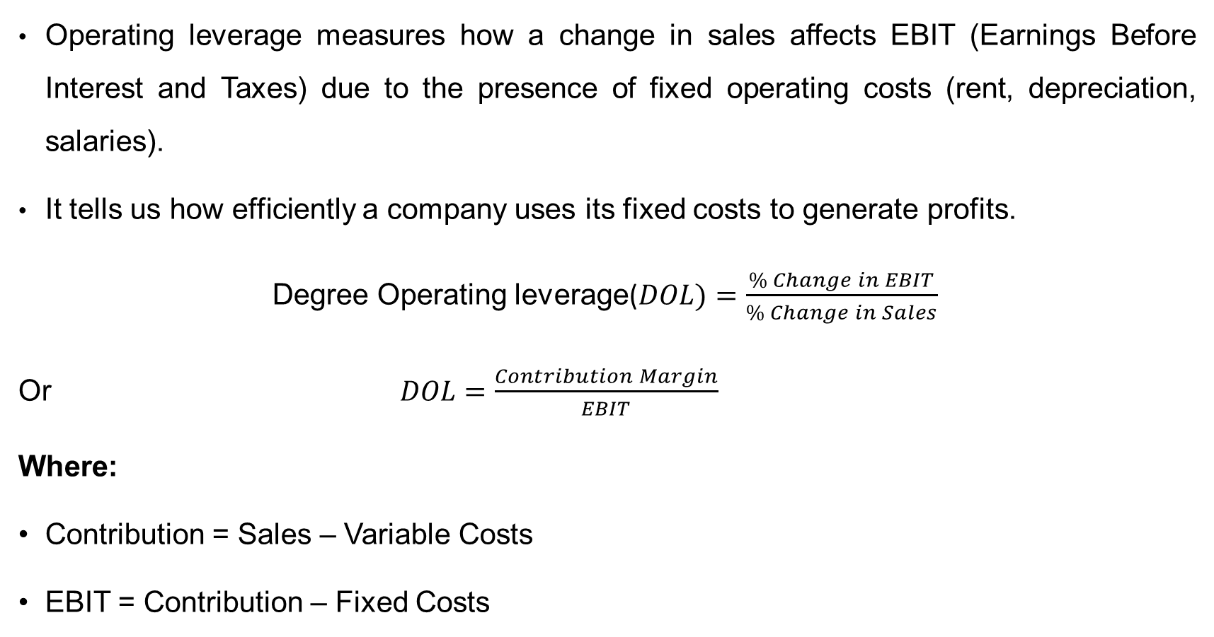
Operating Leverage
Operating leverage measures how a change in sales affects EBIT (Earnings Before Interest and Taxes) due to the presence of fixed operating costs (rent, depreciation, salaries).
It tells us how efficiently a company uses its fixed costs to generate profits.
Degree Operating leverage($DOL)=\frac{\% Change in EBIT​}{\% Change in Sales}​$
Or $DOL=\frac{Contribution Margin​}{EBIT}$
Where:
Contribution = Sales – Variable Costs
EBIT = Contribution – Fixed Costs

Slide 5
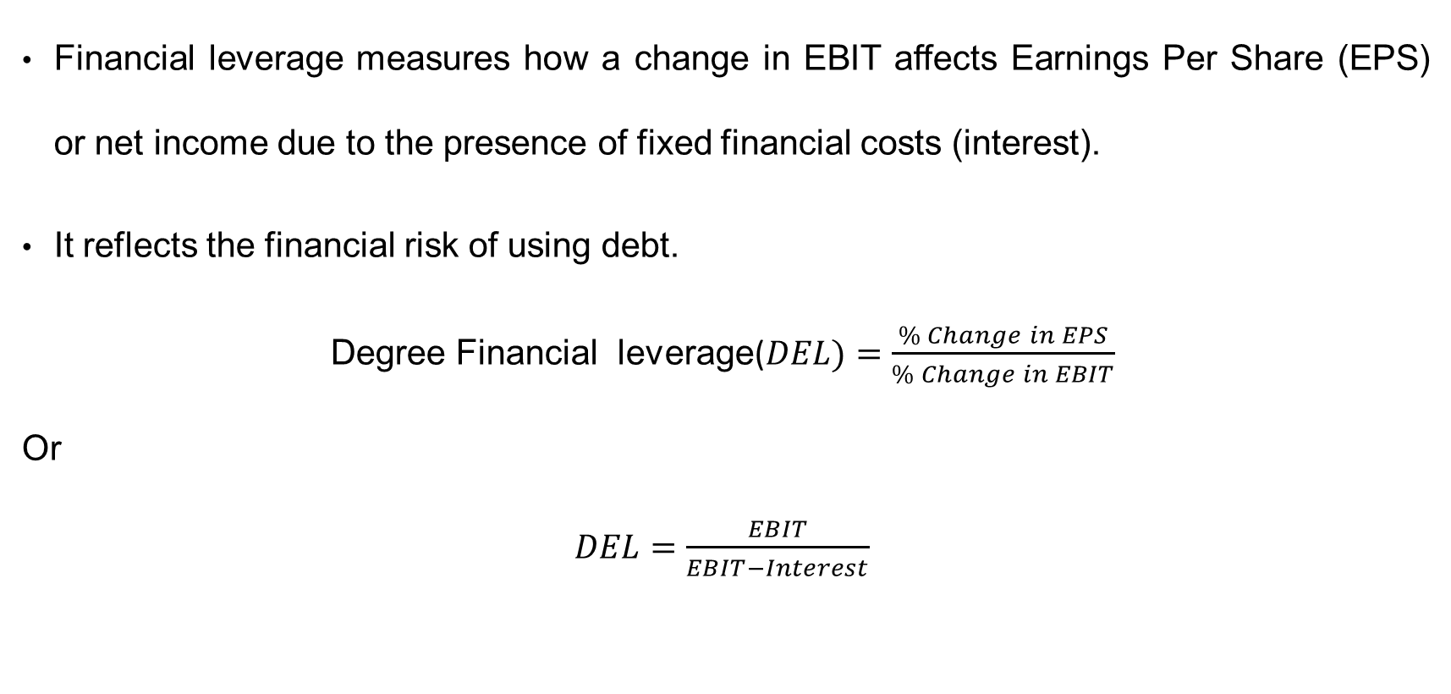
Financial Leverage
Financial leverage measures how a change in EBIT affects Earnings Per Share (EPS) or net income due to the presence of fixed financial costs (interest).
It reflects the financial risk of using debt.
Degree Financial leverage($DEL)=\frac{\% Change in EPS​}{\% Change in EBIT}​$
Or
$DEL=\frac{EBIT​}{EBIT−Interest}$

Slide 6
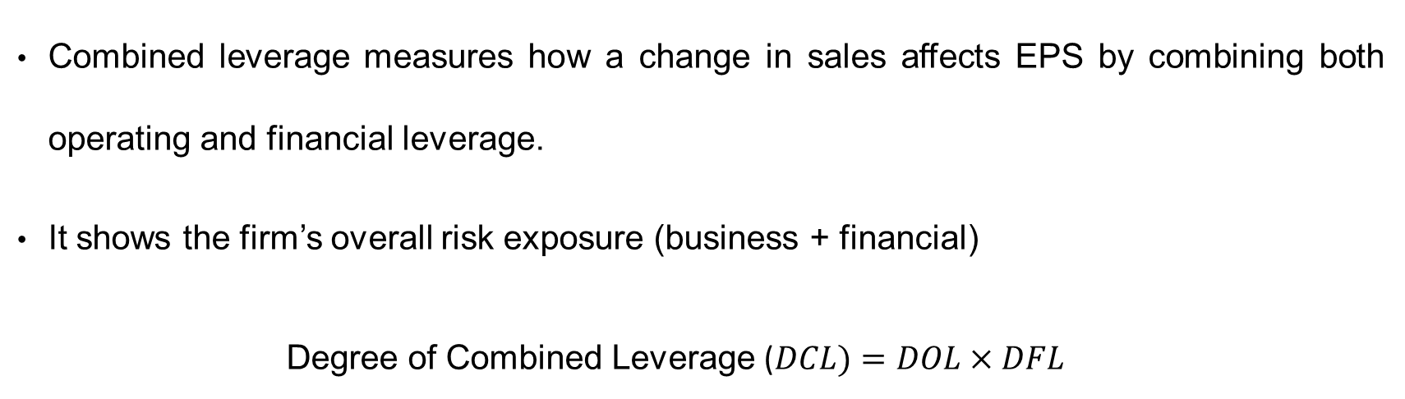
Combined Leverage
Combined leverage measures how a change in sales affects EPS by combining both operating and financial leverage.
It shows the firm’s overall risk exposure (business + financial)
Degree of Combined Leverage ($DCL)=DOL×DFL$

Slide 7
Importance of Leverage Analysis
Profit Planning: Helps management forecast how sales changes affect profits
Risk Assessment: Indicates business risk (operating) and financial risk (financial leverage)
Capital Structure Decisions: Helps determine the optimal mix of debt and equity
Investor Insight: Shows potential volatility in returns and helps assess risk appetite

Slide 8
Particulars | Amount (₹)
Sales | 10,00,000
Variable Costs | 6,00,000
Fixed Costs | 2,00,000
Interest | 50,000
Tax Rate | 30%
Calculate the Degree of Operating Leverage (DOL), Degree of Financial Leverage (DFL), and Degree of Combined Leverage (DCL).

Slide 9
Risk Associated with Leverage
Business Risk:
Business risk means the chance of not earning enough profit from your normal business operations.
It happens because of things like:
Changes in demand or sales
Increase in production cost
Competition or economic slowdown
Financial risk :
Financial risk means the chance of not being able to pay interest or debt when a company uses borrowed money.
It arises when a firm uses debt (loan) because interest must be paid even if profit is low.

Slide 10
Thank You

